Slide 1

EcoWatt - Power Prediction System
Group members with Student Id
Manas Jagtap(23206011)
Jay Yadav(23206007)
Pranal Vernekar(23206008)
Soham Waradkar(23206002)
Project Guide
Prof. Sayali Badhan

Slide 2
Outline
Introduction
Literature Survey of the Existing Systems
Limitations of the Existing Systems
Problem Statement
Technologies Stack for Proposed System
Details of Database / Input to the System
Block Diagram
Implementation(Partial)
Conclusion
References

Slide 3
Introduction
Predicting the power output of wind turbines is essential for improving the efficiency and effectiveness of wind energy systems.
This project explores a method for forecasting wind turbine power using machine learning techniques combined with weather data.
By analyzing historical data on wind speed, direction, and other relevant factors, we developed a predictive model that estimates turbine power output.
We tested our model with data from several wind farms and found that it performed better than traditional methods like linear regression

Slide 4
Literature Survey of the existing system
“Wind Turbine Power Output Forecasting Using Artificial Intelligence”, Tejas Bhardwaj et. al.(2022)
In this paper, wind turbine power output is predicted using Artificial intelligence (AI) techniques. The AI techniques used for predictions are Machine Learning (ML) algorithm and Deep Learning (DL). In ML, polynomial regression is used and Long Short Term Memory(LSTM) was used in DL. This forecasting is long-term forecasting that uses three years of data collected from NIWE (National Institute of Wind Energy) and the results can be used directly for the planning of energy management. Various environmental factors were taken into consideration for forecasting for better accuracy and results. The AI helps to predict the wind turbine output with high accuracy by considering the linear and non-linear types of dataset. This technique can also be used for the preventive maintenance of wind turbines and before the installation of wind power plants in an unfamiliar place to determine the corresponding wind potential.

Slide 5
“A Comparative Study of Machine Learning Techniques for Wind Turbine Performance Prediction”, S. Muralidharan et. al.(2023)
This paper describes a comparative study of various machine learning techniques for wind turbine performance prediction. The dataset used in this study is obtained from the National Renewable Energy Laboratory (NREL) and contains meteorological data and power output from a wind turbine. The machine learning techniques considered in this study include artificial neural networks (ANN), decision trees (DT), and random forests (RF). The results show that RF outperforms ANN and DT in terms of RMSE and MAE, while ANN outperforms DT and RF in terms of R-squared. Overall, this research demonstrates the effectiveness of machine learning techniques for wind turbine performance prediction and provides insights on the advantages and disadvantages of certain machine learning approaches. The findings of this research can be used to guide wind farm managers in selecting appropriate machine learning techniques for wind turbine performance prediction.

Slide 6
Limitations of Existing Systems
Current forecasting methods often struggle to accurately predict shortterm power output due to the intricate and dynamic nature of wind patterns.
Traditional models fail to account for the complexity of wind behavior, leading to unreliable predictions.

Slide 7
Problem statement
As the global shift toward renewable energy accelerates, wind power has emerged as a crucial component of sustainable energy portfolios.
Current forecasting methods often struggle to accurately predict shortterm power output due to the intricate and dynamic nature of wind patterns.
This project aims to address these challenges by developing advanced machine learning models designed specifically for wind power forecasting.
By implementing sophisticated algorithms and integrating diverse data sources, the project seeks to improve the accuracy of wind power predictions while optimizing computational efficiency

Slide 8




Technology Stack for Proposed System
PYTHON FLASK
VISUAL STUDIO
REACT JS
TAILWIND CSS
FIREBASE

Slide 9
Details of Dataset / Input to the System
Title: Turbine Performance
Data Description: This dataset contains measurements from a turbine, capturing various parameters related to its operation and the environmental conditions it operates under. The data includes wind speed, pressure, temperature, datetime, and the power generated by the turbine.
Parameters: Datetime: The exact date and time when the data was recorded.
Wind Speed: The speed of the wind at the time of recording (typically measured in meters per second or kilometers per hour).
Pressure: The atmospheric pressure at the time of recording (usually in pascals or bar).Temperature: The ambient temperature at the time of recording (measured in degrees Celsius or Fahrenheit).
Power Generated: The amount of power generated by the turbine (measured in watts, kilowatts, or megawatts).File Format: Excel (.xlsx)Usage: This dataset can be used for analyzing the relationship between environmental conditions and the performance of the turbine.
Link:https://docs.google.com/spreadsheets/d/1GoOOzCr9IeeSOuP1Svv0JxVyGAieac7y/edit?usp=sharing&ouid=117480550688737575286&rtpof=true&sd=true

Slide 10
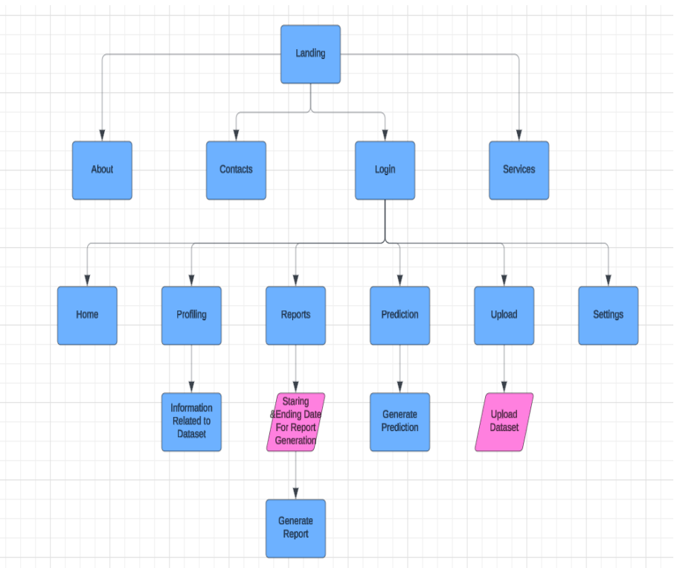
Block Diagram

Slide 11
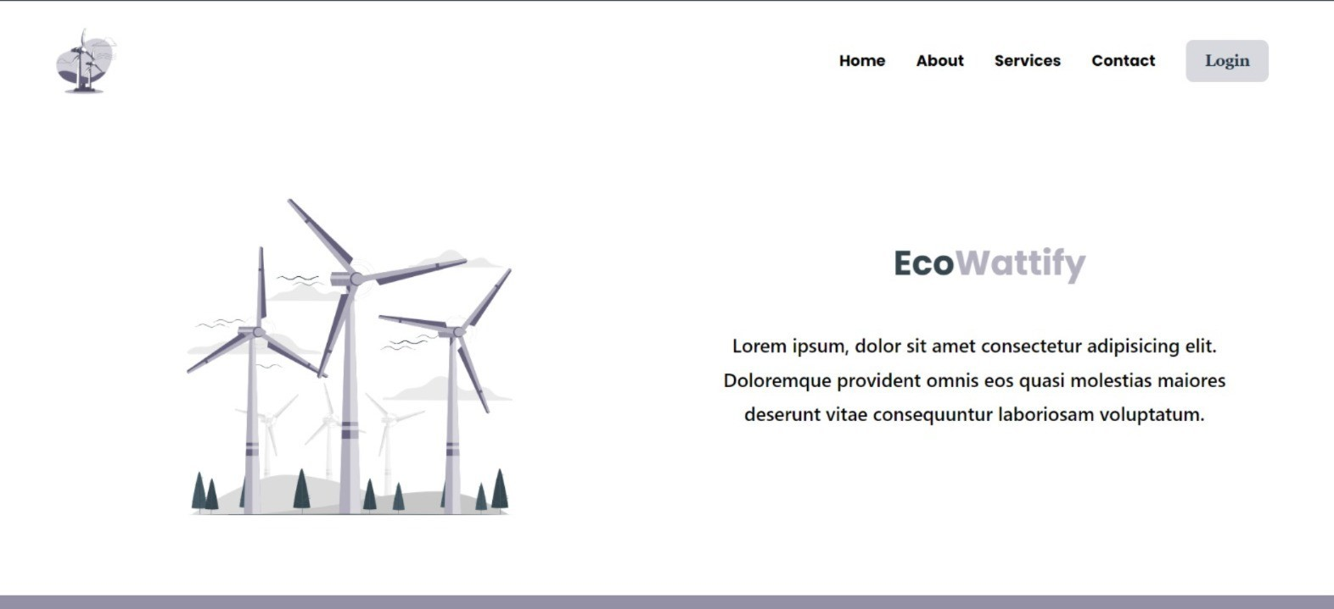
Home Page
Implementation

Slide 12
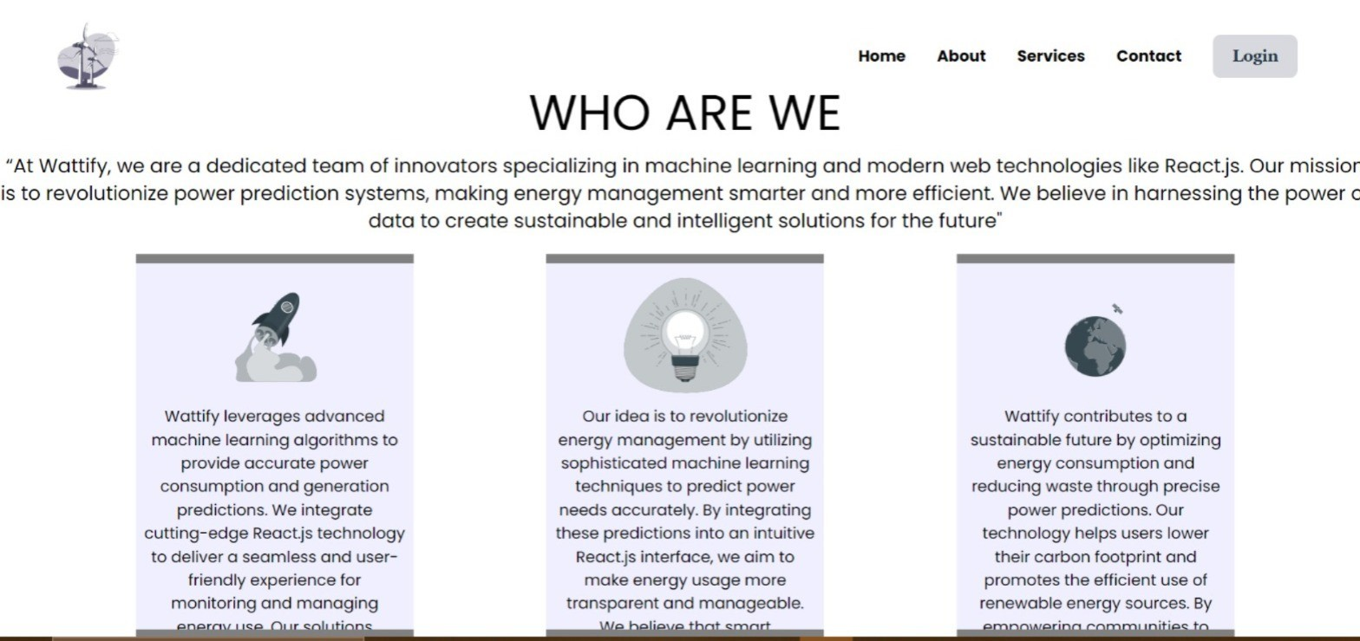
About us

Slide 13

Contact US

Slide 14
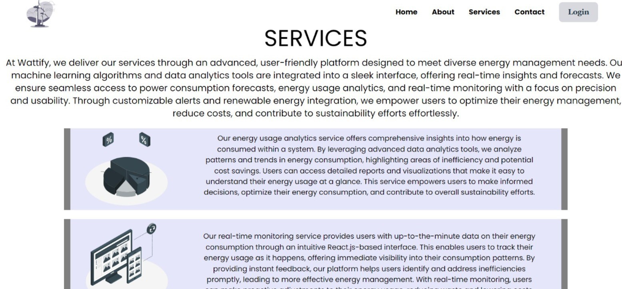
Services

Slide 15
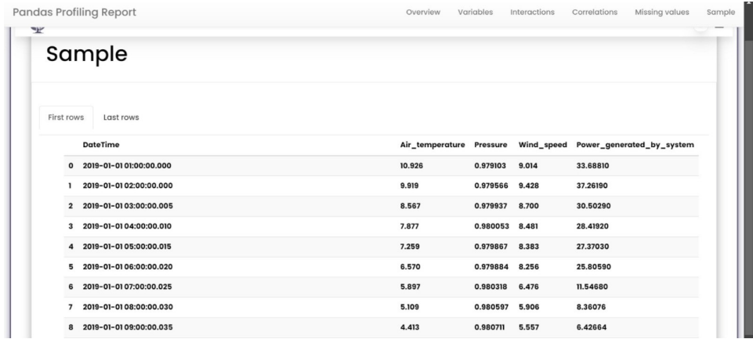
Profiling

Slide 16
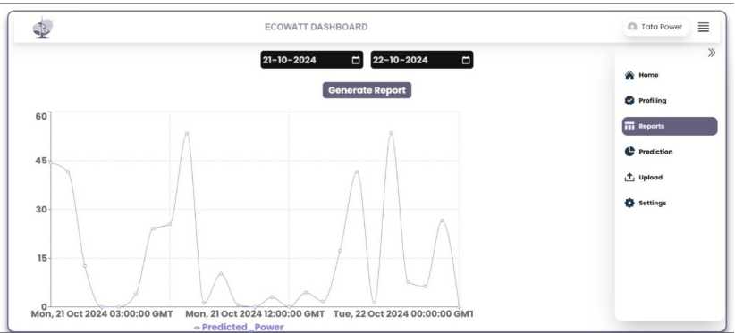
Reports

Slide 17
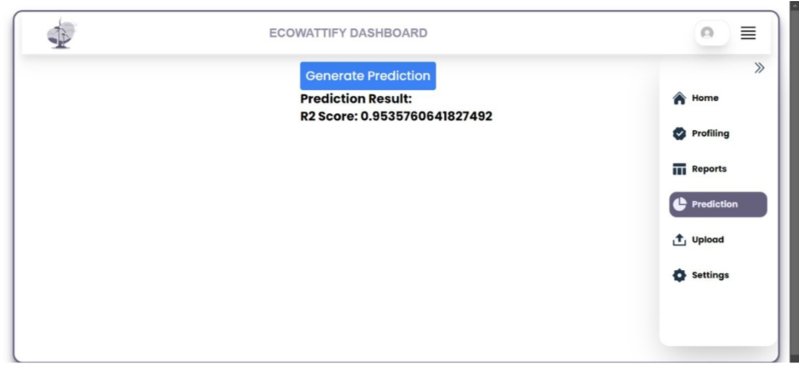
Prediction

Slide 18
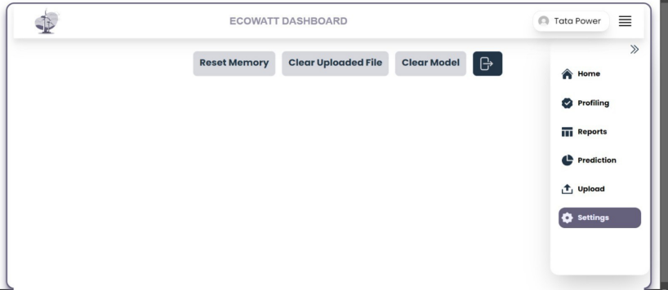
Settings

Slide 19
Conclusion
Accurate wind power forecasting is crucial for the effective management of wind energy and its integration into the power grid.
The development of advanced machine learning models holds the potential to significantly enhance the accuracy of wind turbine power output predictions.
By leveraging sophisticated algorithms and integrating diverse data sources such as historical wind data, real-time meteorological forecasts, and turbine-specific parameters this project aims to address the limitations of traditional forecasting methods.

Slide 20
References
1. “Wind Turbine Power Output Forecasting Using Artificial Intelligence”,Tejas
Bhardwaj, Sumit Mehenge & B. Sri Revathi, International Virtual Conference on Power Engineering Computing and Control: Developments in Electric Vehicles and Energy Sector for Sustainable Future (PECCON), 2022.
2. “A Comparative Study of Machine Learning Techniques for Wind Turbine Performance Prediction”, S. Muralidharan, S.Parthasarathy, Deepa A & Jermin Jersha, International Conference on Smart Engineering for Renewable Energy Technologies (ICSERET), 2023
3. “Real-time power prediction approach for turbine using deep learning techniques”, Lei Sun, Tianyuan Liu, Yonghui Xie, Di Zhang, Xinlei Xia, MOE Key Laboratory of Thermo-Fluid Science and Engineering, 2021
4. “Short-Term Power Prediction of Wind Turbine Applying Machine Learning and Digital Filter”, Shujun Liu, Yaocong Zhang, Xiaoze Du, Tong Xu & Jiangbo Wu, Lanzhou University of Technology, 2023

Slide 21
Thank You...!!

